Slide 1
The Murder of James King and Its Impact on the First Medical Schools of the Pacific Coast
George Yang
Stanford University
2013 Halsted Society

Slide 2
Medicine in the 1800’s
Bleeding remained a major treatment for many diseases.
Infectious disease was most common cause of mortality with malaria and cholera leading causes.
Approximately 19 deaths per 1000 with life expectancy of 39 years at mid-century.
Use of ether as an anesthetic described in 1846.
American Medical Association founded 1847.
Louis Pasteur develops germ theory of disease - 1860’s.
Lister’s description of antiseptic technique - 1867.
Halsted’s use of rubber gloves in surgery - 1890.
Notes:
The term anesthesia was coined by Oliver Wendell Holmes, Sr.

Slide 3
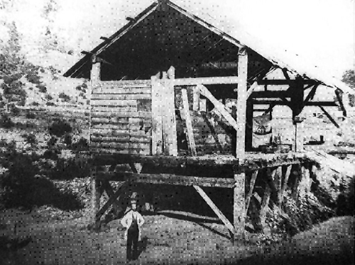
California
War with Mexico in 1846 led to annexation of California by the US.
Gold found in 1848 at Sutter’s Mill
California granted statehood in 1850

Slide 4
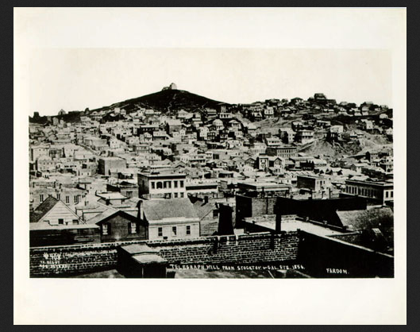
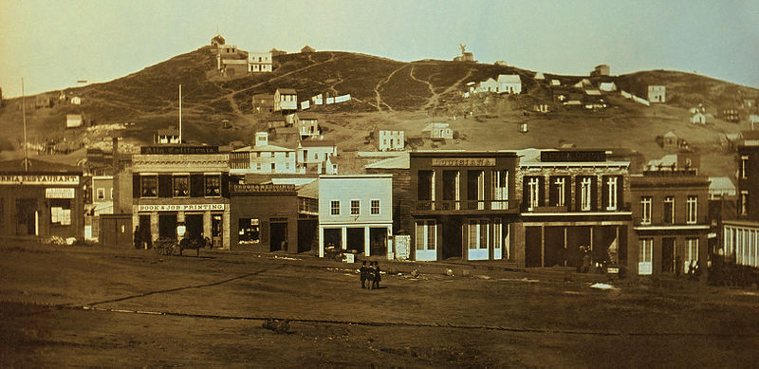
San Francisco
Spanish settlement of Yerba Buena renamed San Francisco in 1847.
San Francisco had a population of 200 in 1846, and 50,000 by 1855

Slide 5
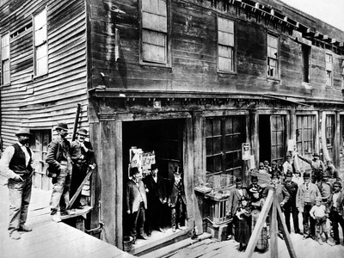
San Francisco
Was the largest city on the American west coast (Seattle, Portland, Los Angeles and San Diego all having only a few hundred inhabitants each).
In 1855, over 500 places selling liquor, 12 gambling halls, 48 “fancy” and dance houses.
Majority of the population was male, and lived in tents on mud streets. Arson, robbery and murder were commonplace.

Slide 6
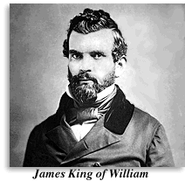
James King of William
Born Jan 28, 1822 in Georgetown, MD and learned finance
Lured to Sierra gold camps in 1848
Moved to San Francisco in 1849 to start a bank

Slide 7
James King of William
Initially prospered but corrupt employee caused him to go bankrupt
Developed anger at his ruin and chose journalism as his weapon to attack those he thought brought him to this point

Slide 8
Daily Evening Bulletin
First published in 1855 by King with his brother, Thomas, giving him financial support
Exposed corrupt practices between banks and politicians
Attacked all perceived corruption present in San Francisco
Quickly became the leading newspaper of the city
Had a pro-Union bias in the turmoil prior to the Civil War

Slide 9
James P. Casey
Publisher of the rival paper, the Sunday Times with a pro-South bias, even though he was illiterate
Was known to engage in ballot-box stuffing during elections; gained election as Supervisor of a district he did not even live in
Spent 18 months in Sing Sing Prison in New York at hard labor for robbing his mistress

Slide 10
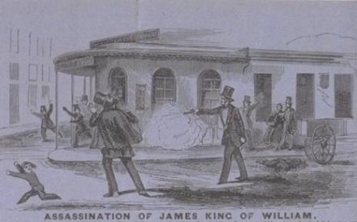
The Shooting
King wrote an editorial critical of Casey mentioning his history as an ex-convict at Sing Sing
On May 14, 1856, Casey fired a single shot from a revolver that struck just below the lateral third of the clavicle and exited the back

Slide 11
Immediate Aftermath
Casey ran to the local police station for protection and was subsequently sent to the County Jail because mobs came looking for him
King was brought into the Pacific Express office that he had been shot in front of and medical help was summoned

Slide 12
Initial management
First doctor to arrive was RK Nuttall. He explored the wound with his finger and found it coursed upwards, inwards and backward through the chest wall
Bleeding was initially profuse and then slowed. Noted to be dark suggesting venous bleeding
No pulse was noted on the left and a weak one was noted on the right
Beverly Cole arrived next and placed mustard plasters and heat to restore circulation. King pleaded with Cole to stay and treat him

Slide 13
Wound Management
Soon joined by HM Gray and William Hammond. Hammond was King’s personal physician and assumed control
Gray and Nuttall advocated putting a plug into the wound to prevent further bleeding
Cole objected because he felt it would block drainage and lead to infection
A sponge the size of a goose egg was soaked in water and inserted into the wound with pressure and secured with wet compresses and bandages
Hugh Toland, as the foremost surgeon of San Francisco, was consulted that evening

Slide 14
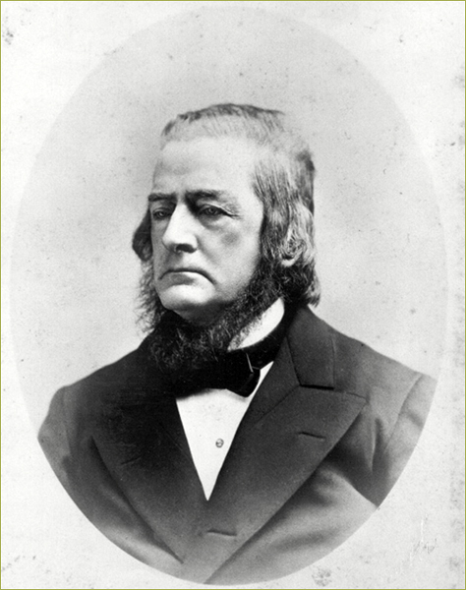
Hugh Huger Toland
Born in South Carolina to a planter and banker.
“Read medicine” and worked in an apothecary at 16. Graduated from Transylvania Medical College at Lexington, KY in1828.
Did post-graduate work at Salpetriere in Paris at the same time as Oliver Wendell Holmes.

Slide 15
Hugh Huger Toland
Practiced in the east and midwest until coming to San Francisco in 1852.
Had a successful surgical practice at Montgomery and Merchant.
Appointed surgeon to the State Marine Hospital, forerunner of the San Francisco City and County Hospital.

Slide 16
Toland’s recommendation
Hammond convened a consultation with Gray and Toland
Based upon observation and the account of Nuttall, Toland concluded the subclavian artery was severed without examination. Recommended leaving sponge
Cole and Nuttall were excluded. Cole still advocated removing the sponge and ligating the artery if necessary. Nuttall noted the sponge was only meant to be a temporary measure
Elias Cooper was a friend of Cole’s, and Cole asked him to come give his advice. Thomas King also requested Cooper come to give consultation

Slide 17
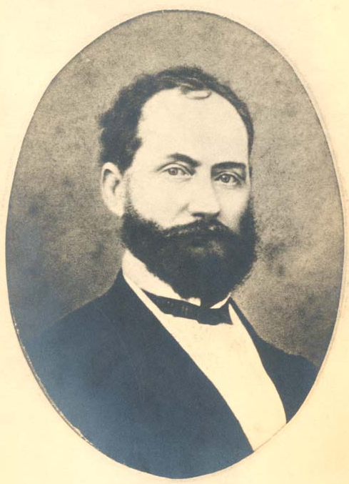
Elias Samuel Cooper
Born to Jacob and Elizabeth Cooper on Nov. 25, 1820 near Somerville, Ohio
Unclear early formal education.
Apprenticed to Dr. Waugh in Indiana in 1838-39.
Apprenticed to older brother Esaias from 1840-43.
Awarded MD ad eundem from St. Louis University in 1851.
Notes:
Grandparents William and Mary Cooper were Quakers who moved to Ohio from South Carolina in 1807 to protest the introduction of slavery to their original home district. Ohio at the time represented the far west as the Northwest Territory was purchased by the US in 1787. As Quakers, the Coopers’ ancestors immigrated from England in 1699 to escape religious persecution.

Slide 18
“ad eundem” Degrees
That the candidate be twenty-one years of age, of good moral character and have been engaged in the study of medicine for three years (courses of lectures included).
That he shall have attended two full courses of lectures in this Institution (duration of course, 4 1/2 months: 15 October through February). Attendance on a regular course in some respectable and generally accredited medical school, or four years of reputable practice will, however, be considered as equivalent to one of the courses above specified.
That he shall undergo a satisfactory examination on all the branches taught in this College, and write an acceptable Thesis, either in the English, Latin, French or German language, on some subject connected with medicine.
Candidates, applying for the degree ad eundem, must show written and satisfactory testimony that they are graduates of a generally acknowledged school of medicine - that they have been engaged in practice at least two years, without having followed, during that time, any other occupation.
Fees for the whole course amount to $105. The Matriculation ticket (paid but once) is $5; that of the Demonstrator, $10; the Hospital tickets are gratuitous; and the graduation fee is $20.
Notes:
Requirements for ad eundem degrees from St. Louis Univ. Essentially, earned MD with 4 1/2 months lectures

Slide 19
Elias Samuel Cooper
Worked in Danville, Illinois after apprenticeship with Esaias ended in 1843
Moved to Peoria, Illinois in 1844 to find a busier practice and would practice until 1855
Applied for professorships in anatomy at Rush Medical School and University of Iowa but denied both.
Helped found Peoria Medical Society and Illinois State Medical Society.
Notes:
Grandparents William and Mary Cooper were Quakers who moved to Ohio from South Carolina in 1807 to protest the introduction of slavery to their original home district. Ohio at the time represented the far west as the Northwest Territory was purchased by the US in 1787. As Quakers, the Coopers’ ancestors immigrated from England in 1699 to escape religious persecution.

Slide 20
Elias Samuel Cooper
Cooper is active in the societies presenting his first paper on congestive fever in 1850.
Described his use of chloroform for surgery in 1851.
Censured in 1853 for advertising.
Visited clinics in Europe from 1854-1855.
Closes clinic upon return and arrived on May 26, 1855 in San Francisco.
Notes:
Grandparents William and Mary Cooper were Quakers who moved to Ohio from South Carolina in 1807 to protest the introduction of slavery to their original home district. Ohio at the time represented the far west as the Northwest Territory was purchased by the US in 1787. As Quakers, the Coopers’ ancestors immigrated from England in 1699 to escape religious persecution.

Slide 21
Controversy Builds
Cooper recommended exploration and ligation of the subclavian artery if needed
Cole and Cooper were familiar with Joseph Pancoast’s writings on the operative approach to the subclavian artery and felt comfortable tackling it unlike Toland
Hammond had Cooper thrown out
Cole felt King had asked him to treat him and withdrew from the case in protest
By the end of that day, the arm was paralyzed, cold, blue and swollen

Slide 22
Decline and Death
Over the next few days, there was no change in the patient’s condition
John S Griffin, a former army surgeon, was brought from Los Angeles to consult on the fourth day at the request of Toland. He also advised against removing the sponge
The infection was severe enough on this day that an incision was made in the left armpit to drain considerable pus under chloroform anesthesia
King progressively declined and died 6 days after being shot

Slide 23
Post-Mortem
Subclavian artery was intact
Some damage and phlebitis around the subclavian vein
The brachial plexus was torn apart
Caseous (tuberculous) masses were found in the lungs
Pleural inflammation and approximately 500 cc of serosanguinous fluid in the left chest

Slide 24
Casey’s fate
Vigilance Committee formed to enact justice
On the fourth day after King was shot, 2600 armed men from the Vigilance Committee went to the County Jail and demanded Casey
Casey was handed over by the Sheriff to avoid added bloodshed along with Charles Cora, a man accused of shooting an unarmed marshal
Casey and Cora were tried by the Vigilance Committee and sentenced to death by hanging

Slide 25
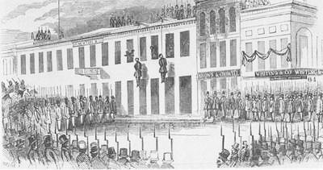
Burial and Hanging
King buried on Thu, May 20
Casey and Cora were hung at the fort of the Vigilance Committee on the same day

Slide 26
Letter to the Editor by Cooper
“Have we no qualified surgeons among us? This inquiry is made in consequence of having heard it stated frequently within a few days past that the subclavian artery could not be tied above the clavicle. I know that the thing can be done.”

Slide 27
Letter to the Editor by Cooper
“I should like therefore to have some of the learned gentlemen who cared for James King attempt to prove that the most consummate ignorance was not displayed in his treatment from the moment of his injury to the period of his death. If there is anyone of this clique who dares to come out over his own signature and say that the treatment of Mr. James King of William was judicious, I will prove that plugging up a gunshot wound to arrest hemorrhage under the impression that the subclavian artery was shot away denotes more consummate ignorance of the principles of surgery on the part of anyone practicing the same than can be often found at this enlightened day.”

Slide 28
Letter to the Editor by Cooper
“You are the criminally ignorant surgeons who in the case of James King tried to plug up a wound as you ignorantly supposed of the subclavian artery. Where is the intelligent medical man of this city who doubts for one moment you killed that patient?... I take this occasion to call (King's doctors) to account for the criminal ignorance they displayed in his treatment.”

Slide 29
First Medical School of the West
Cooper establishes the Medical Department of the University of the Pacific in 1858
Cooper dies of unknown ailment in 1862
Succeeded by nephew Levi Cooper Lane, also a surgeon

Slide 30
Toland Medical School
Hugh Toland starts planning his own school in 1860 to compete with Cooper, opens in 1865
Uses money and affiliation with San Francisco City and County Hospital
Coaxes Lane to merge

Slide 31
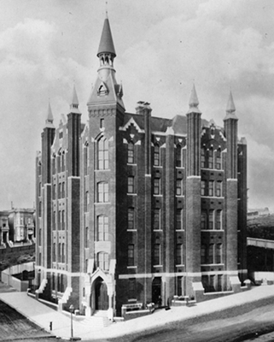
Cooper Medical School
Lane feels memory of Cooper is disparaged
Resurrects the Medical Department in 1870
Renamed Medical College of the Pacific
Raises money to build new school and hospital to be named the Cooper Medical School in 1882

Slide 32
The Final Metamorphosis
Toland enters discussions to join a university
In 1873, Toland Medical School becomes…
UCSF
The Medical Department of the University of California

Slide 33
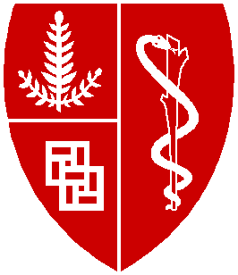
The Final Metamorphosis
Lane begins discussions to merge in 1901 with final approval in 1908 becoming…
Stanford University School of Medicine

